Slide 1
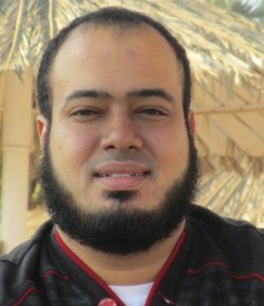
Competitive Programming From Problem 2 Solution in O(1)
P
T
H
I
N
K
F
A
S
T
S
C++11
Mostafa Saad Ibrahim
PhD Student @ Simon Fraser University

Slide 2
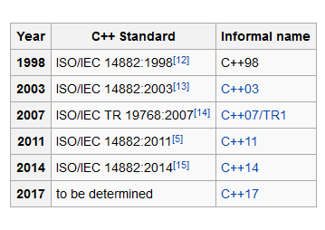
C++ History
Starts in 1979 - Bjarne Stroustrup

Slide 3
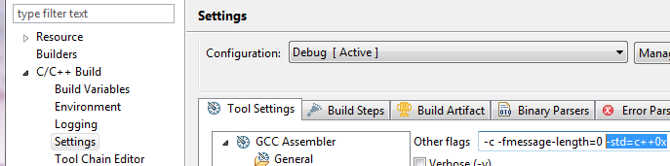
Adding C++11 to a project

Slide 4
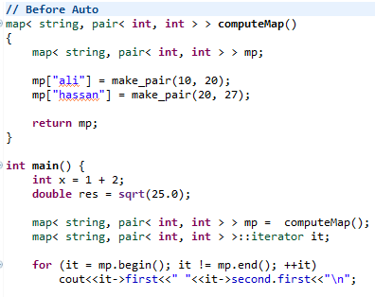
Without auto specifier

Slide 5
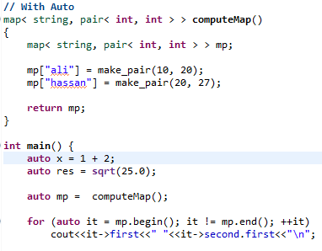
With auto specifier
automatically deduced from its initializer

Slide 6
Initializer lists
We used to use intializer lists but in limited scope only.
E.g. int arr[] = {1, 2, 3, 7};
This {some staff} is called intializer list

Slide 7
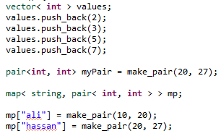
Without Initializer lists

Slide 8
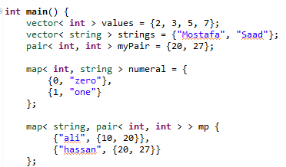
With Initializer lists

Slide 9
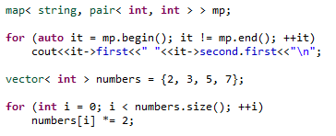
Without Range Loops

Slide 10
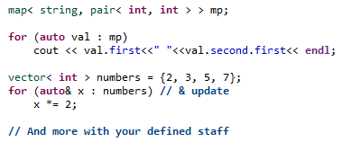
With Range Loops

Slide 11
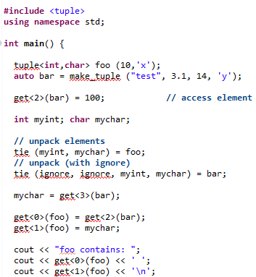
Tuple

Slide 12
Variadic Functions
So far when we create function, we know exact number of parameters
Now, we can have them dynamic list!
This is similar to C printf
printf(“%d”, 10);
printf(“%d %d”, 10, 20);
And whatever lenfth

Slide 13
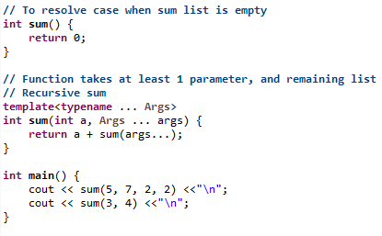
Variadic Functions

Slide 14
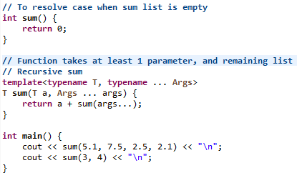
Variadic Functions

Slide 15
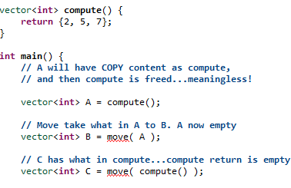
Move

Slide 16
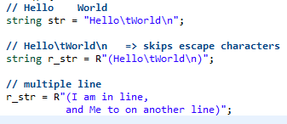
Raw Strings

Slide 17
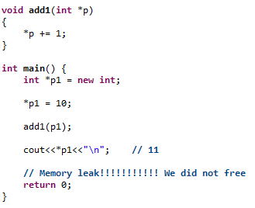
Without shared pointers

Slide 18
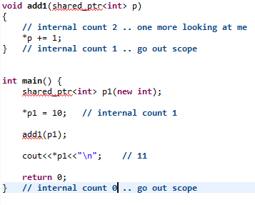
With shared pointers

Slide 19
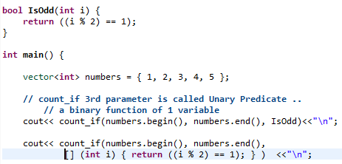
Lambda function

Slide 20
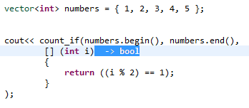
Lambda function

Slide 21
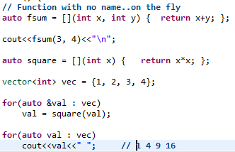
Lambda function

Slide 22
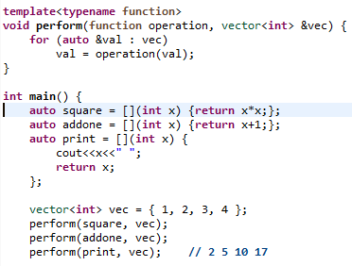
Lambda function

Slide 23
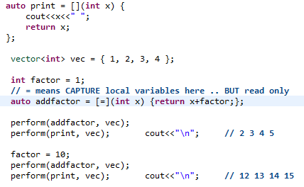
Lambda function

Slide 24
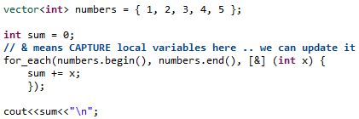
Lambda function

Slide 25
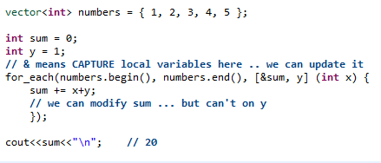
Lambda function

Slide 26
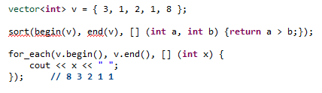
Lambda function

Slide 27
More ...
Nice Playlist
Weak Pointers, Unique Pointers
Regular Expressions
Some of today examples based on
http://codeforces.com/blog/entry/15643
http://codeforces.com/blog/entry/10124

Slide 28
تم بحمد الله
علمكم الله ما ينفعكم
ونفعكم بما تعلمتم
وزادكم علماً

